Slide 1
BetterBeatMatchTM
Bailey Anderson

Slide 2
Problem - DJing a great set requires a DJ to find the perfect track to transition to, but this can be a difficult task. A DJ must pick a track with:
A BPM (beats per minute) similar or identical to the current track
A key that is identical or one step above or below the current track
A track in the same genre. For example, you would want to transition a drum and bass song into another drum and bass song to maintain flow

Slide 3
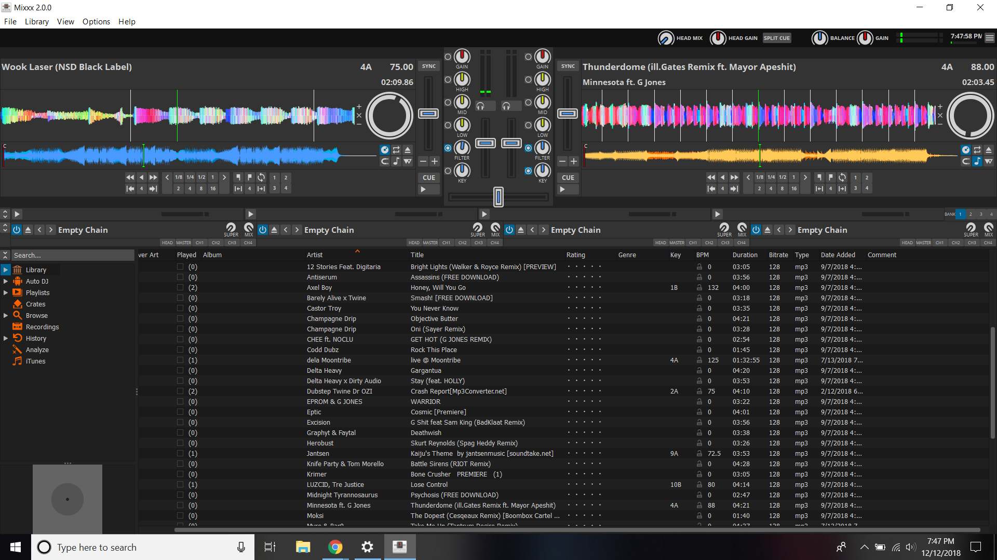

Slide 4
Solution: BetterBeatMatchTM
Allows users to:
Sort tracks based on BPM, key, genre, subgenre, artist, and more!
QuickSortTM function: enter the current song and sort based on the optimal BPM, key, and subgenre for fast access to the perfect smooth transition to the filthiest of bass drops

Slide 5
Tables
Songs
SongID | Song | Subgenre | Key | BPM | Duration | Comments | ArtistID
1 | G Shit | Dubstep | A | 70 | 200 |  | 1
2 | Robo Kitty | Dubstep | G | 88 | 300 |  | 1
3 | Vibin | Bass House | C | 70 | 350 |  | 2
4 | Moontribe Mix | Neuro Funk | B | 128 | 256 |  | 3
Artists
ArtistID | Artist | Genre
1 | Excision | Bass
2 | Habstrakt | House
3 | Dela Moontribe | Drum and Bass
4 | Space Jesus | Bass

Slide 6
Areas for Improvement and
Future Design Aspirations (BestBeatMatchTM)
Lack of GUI means that users must type commands, not optimal for the command line inept
Implement BetterBeatMatch as a feature of mixing software such as Mixxx
Optimize for unorganized data from a single CSV

Slide 7


Slide 8


Slide 9


Slide 10


